Slide 1
16 Days of Activism for No Gender-Based Violence 2020
“Women’s Economic Justice for a non-violent and non-sexist South Africa”
Call to action to the nation campaign
“Working together to Build a Society where Morality takes Prevalence”
“We have a responsibility not to fold our arms while we are witnesses to moral degeneration. We need to be torchbearers and light the way to a society that is morally stronger than we currently have.” - OR Tambo

Slide 2
Background
16 Days of Activism for No Gender-Based Violence 2020 will be recognized under the theme: “Women’s Economic Justice for a non-violent and non-sexist South Africa”
It is well documented that South Africa (SA) has one of the highest rates of Gender-Based Violence in the world (5 times higher than the global average).
The 16 Days of Activism for No Gender-Based Violence (16 Days Campaign) is a United Nations campaign which takes place annually from 25 November (International Day of No Violence against Women) to 10 December (International Human Rights Day).
The launch of 16 Days of Activism takes place during Disability Rights Awareness Month.
Government launched the Campaign in 1998. However, the scourge of violence against women and children persists in part due to the ineffective implementation of policies and frameworks, as well as persistent patriarchal systems that place a value on women in relation to their servitude to men and society. Toxic cultural and religious practises also devalue women and consider them of less value to men.
Therefore preventing gender-based violence and femicide before it happens is critical.

Slide 3
Call to action to the nation Activity 1:
Pillar 2 of the National Strategic Plan on GBVF titled, Prevention and Rebuilding of Social Cohesion, focuses on the elimination of social acceptance of all forms of violence against women, children, and LGBTQIA+ persons through developing and implementing evidence-based programmatic interventions. The NSP states: Effective prevention means addressing the range of risk factors that drive gender-based violence, femicide and violence and contribute towards the normalisation of violence (Page 44)
Preventing gender-based violence and femicide before it happens is critical. Key to this prevention is moral regeneration
Moral regeneration involves recognition and application of universal values as found in section 1 of the Constitution
These values include human dignity, equality and freedom, the most important of which is human dignity, accorded to all in South Africa.
As part of prevention mechanisms, we need to eradicate ills and build a society where morality takes prevalence. Therefore, a Call to Action to the nation, as well as a thread for media conversations and coverage must hinge on the Call to Action: “Working together to Build a Society where Morality takes Prevalence’
Moral Regeneration is aimed at encouraging people to recommit to efforts of building communities grounded on positive values and re-dedicate to building a caring society in pursuit of creating lasting peace and prosperity in the country, most importantly, to
Instil , accountable , responsible ,ethical and empathic leadership in order to achieve the overall NSP goals

Slide 4
Call to action creative rationale
Recently we have heard of the most gruesome cases of GBVF a 17 year woman who was raped by 11 men, an alleged case of a father raping his own children, a serial killer in kzn who raped and killed women, the case of a 4-year old boy found stuffed into a box in the northern cape, and many more.
It must also be taken into consideration that perpetrators of GBVF are also becoming younger and younger. This points to a moral degeneration, broken family and communities structures, persistent patriarchal systems that place a value on women in relation to their servitude to men and society. toxic cultural and religious practises also devalue women and consider them of less value to men.
We have a responsibility not to fold our arms while we are witnesses to this moral degeneration, which brings the country to the need to have a deep understanding of the root course of GBVF in order to prevent it from taking place .
The youth are the ones who bear the brunt of moral decay. they are often perceived as agents of immoral behaviour or helpless victims, who need some external intervention. they themselves decry the lack of role models and opportunities for right living.
Also we must note that at its centre we are dealing with the issue of value on humanity that requires empathetic leadership. Therefore, in order to achieve objectives of the NSP’s 6 Pillars, we need to repair the social fabric of our nation through building a society where morality takes prevalence.

Slide 5
Call to action key messages
Based on the persistence horrific nature and the scourge of GBVF in the country government is calling upon the nation to recommit to programmatic intervention to:
Repair the social fabric of our nation by eradicate ills and build a society where morality takes prevalence.
Recommit to efforts of building communities grounded on positive values and re-dedicate to building a caring society in pursuit of creating, equality lasting and prosperity in the country .These values involve respect for human life and basic honesty in the way persons and officials act in communion with one another and the authorities.
Build men and women who understand the true meaning of words such as honesty and integrity, and who have respect for the rights of others.
Foster greater religious tolerance and cooperation for moral renewal.
Establish a new society, where men and women will enjoy equal rights and improve the elimination of the system that exploits women to achieve economic justice
Build a society where the ultimate goal is to create an opportunity for each person to establish a sufficient material foundation upon which to have a dignified, productive, and creative life.

Slide 6
Call to action: Collective Responsibility
The media: Promote positive stories and renewal, take collective responsibility and hold society to higher levels of morals, denouncing actions that go against our highest expectations of each and every citizen.
Communities : Condemn any acts of GBVF and report it to the police. We must be the torchbearers and light the way to a society that is morally stronger than we currently have.
Those responsible for making decision: Create awareness about the Nature of GVBF as humanity issue and instill Empathetic, Responsible and Innovative and Accountable leadership in those responsible for making decisions.
Partners :Sexual and personal morality requires intellectual honesty and respect. We are enriched by diverse cultures in South Africa.
Families: Nature values, attitudes, and behaviour. Raise boy and girl child as equals . Family its an important agent in all its cultural and religious manifestations of socialisation and a major instrument in nurturing psychological behavior
Teachers: Look at any signs of psychological behaviors such as bullying, teach young boys to treat girls with respect and as their equal. Teach young girls to be confident, independent and to express their views
Call on men and boys, as well as whole of society to stand as partners (collective responsibility) and form action coalitions (multi-sectoral approach) that seek to eradicate rape and sexual harassment and abuse

Slide 7
Other leveraging opportunities with key identified sectors
Utilise key role models to carry messages such as CEOs of leading organisations across all sectors, taxi drivers , celebrities, Ministers, Politicians etc . Miss SA can serve as an Ambassador .
Moral Regeneration Movement: To respond to the degenerating society
The arts and sports sector: The arts and sports sector can play a major role in carrying the message
Transport Sector: Branding opportunity through ACSA airports spaces taxis and taxi ranks(done)
A formal letter supported by toolkits and communications plan can be shared to all

Slide 8
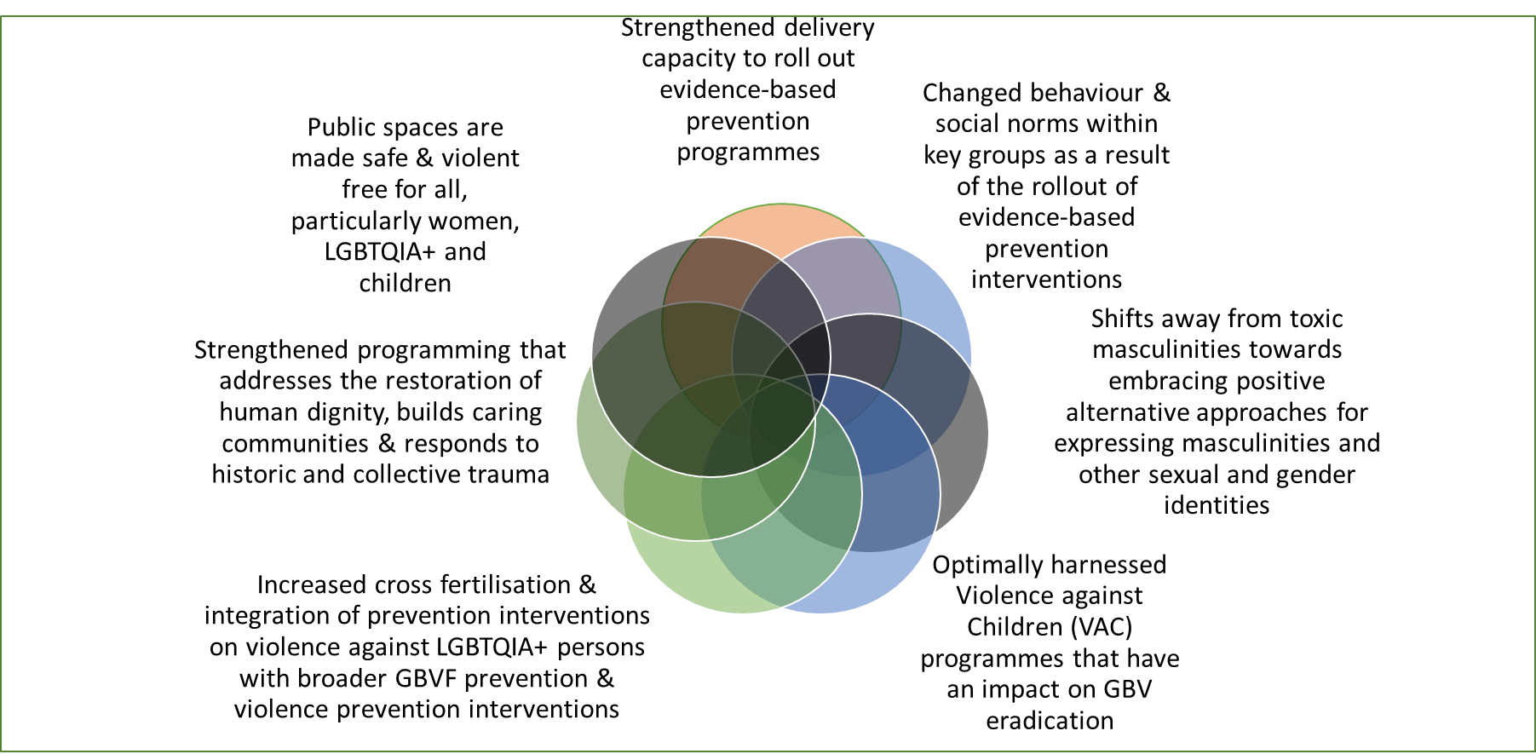
Pillar 2: generic key messages

Slide 9
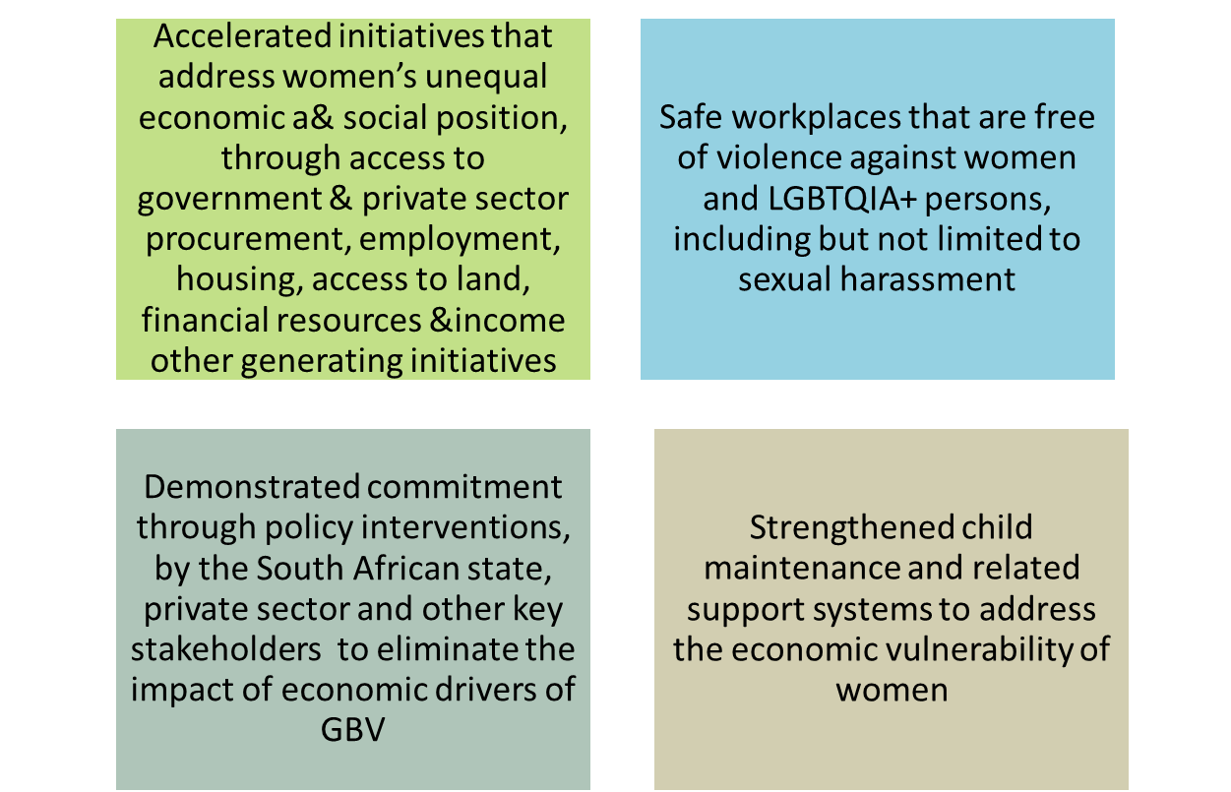
Pillar 5 generic key messages Economic justice is a component of social justice and welfare economics. It is a set of moral and ethical principles for building economic institutions and systems
Pillar 5 of the National Strategic Plan on Gender-Based Violence and Femicide refers to Economic Empowerment which recognises the link between women tolerating abusive situations due to their financial position, and the importance of empowering women to be educated and stand as independent citizens, providing the means to respond differently to signs of abuse.
The theme also refers to women’s role in the world of work, access to opportunities, being treated fairly, with respect, and counted as an equal citizen in production and manufacturing, as well as male-dominated sectors. It also links to women’s ability to leave abusive relationships which they endure due to economic dependency.
This should in turn provide further impetus to strategic interventions which will ensure the radical transformation of gender relations and the political, social and economic empowerment of women, including young women and those with disabilities (MTSF Target).

Slide 10
Social Media Campaign
To be done : Call to action social media banners with creative and hashtags to be targeted to the following to play their part:
The Broadcasters (Briefed already )
Faith Based Organisation
Community Leaders
Traditional Leaders
Moral Regeneration Movement
Youth Formations
Teachers
Learners
Students formations
Civil Society Formations
Political Leaders
Private Sector
Generic messages for the general publics .
Fostering great relationship and partnerships is required in implementing the campaign

Slide 11
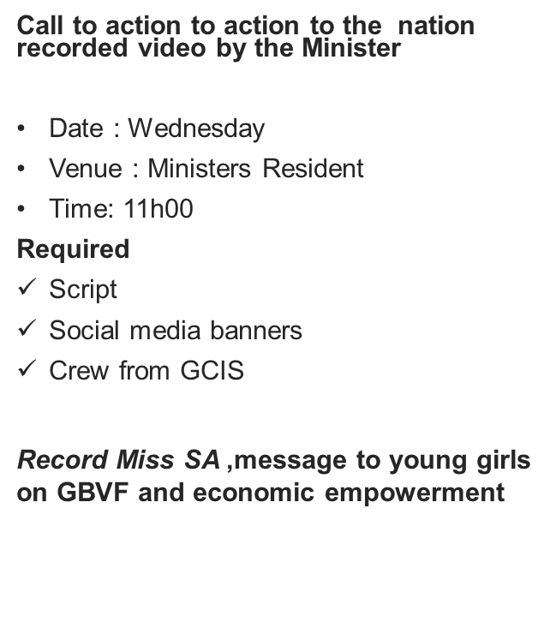
Build up activity 2 and 3
Pre-briefing meeting with all broadcasters on 16 days campaign (done)
Media Statement and Advisories
Congratulating Miss SA Oct 2000
Meeting with the SANTAGO Oct 2000
Opinion piece and articles
Leadership Magazine: Nov 2000
Pubic Service Magazine: Nov 2000
Sunday Newspapers

Slide 12
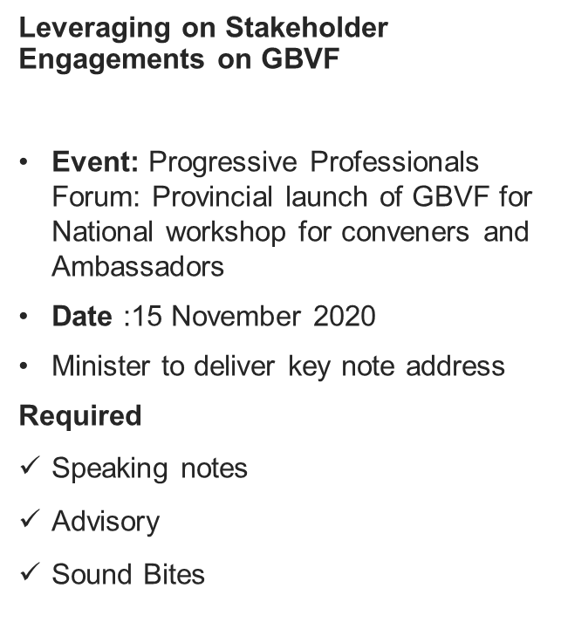
Build up activity 3 and 4
Webinar on virtual mtaxi alliance industry
Theme: “a 365 days safe taxi industry for women youth and persons with disabilities”
Date: 06 November 2020
Time: 10:00 – 13:00
Venue: Microsoft teams meeting
Announce Miss SA as brand ambassador for GBVF and include her in the programme to speak about Psychosocial Behaviour
Required:
Media advisory
Social Media Banners
Sound Bites
Media interviews

Slide 13
During 16 days Campaign proposed comms activities
Dedicate Sunday to a national moment of silence for the victims and those who have lost their lives due to GBVF and a National prayer on building a society free from GBVF
Minister to host a dialogue with young women and girls in partnership with proudly SA, Small Business , CEOs of leading companies in SA and Miss SA
Webinar with Private Sector CEOs to discuss women economic empowerment
Webinar with government senior officials responsible for gender mainstreaming or women empowerment to give an update on women economic empowerment
Minister to host national Imbizo with men and boys on how they can become ambassadors in preventing GBVF with a link to all social media
Signing of the National Pledge on GBVF.Working together to Build a Society where Morality takes Prevalence
Closing event : Be the Light Campaign in partnership with Vodacom

Slide 14
Post 16 days Proposed Comms Activities
Minister to deliver university lectures on economic empowerment and empathetic leadership across the country
Partner with the Department of Basic Education to launch National School Debates on the causes of GBVF, its consequences and how to prevent it from happening ( utilise the current school debate competition platforms)
Written essays competition on how to end GBVF in South Africa, the first 10 best essays to be published in selected newspapers . Winners can be interviewed in all platforms
Partner with youth formations and student leaders to become GBVF ambassadors
Partner with SANTACO for taxi drivers to become GBVF ambassadors (Done)
Partner with ACSA to co-brand all the airport sites
Partner with PSL to project GBVF messages in all their games
Partner with SABC to incorporate GBVF messages on their shows story lines
Encourage gov and all stakeholders to implement the NSP in pillars in partnership with DWYPD

Slide 15
THANK YOU !

